Slide 1
Welcome to Azure Defender + Azure Sentinel Better Together! Day 2

Slide 2
A look into Day 2
Kick-Off | 8:00-8:05 | Welcome | Main Call
 | 8:05-8:30 | Azure Sentinel
 | 8:30-8:45 | Demo Walkthrough
Ingest | 8:45-9:00 | Break
 | 9:00-10:00 | Azure Sentinel
 | 10:00-11:00 | Activity: Data Lake Design & Security Considerations | Table Group Call
 | 11:00-11:15 | Break
 | 11:15-12:00 | Build Hands-on: Data Integration Part 1 | Table Group Call
Transform | 12:00-1:00 | Break | Main Call
 | 1:00-1:30 | Data Transformations
 | 1:30-2:00 | Activity: Data Engineering Discussion
 | 2:00-3:00 | Build Hands-on: Data Integration Part 2 | Table Group Call
 | 3:00-:15 | Closing | Main Call
Today we will be learning and collaborating across three spaces:
Main call (this meeting)
Table Group channel within the event Team
CloudLabs Learner Portal & Lab environment
Presentation/
Whole Group
Lab
Activity/ Discussion/ Group Work
Announcements

Slide 3
Azure Sentinel + Azure Defender Better Together!

Slide 4
Azure Sentinel

Slide 5

Azure Sentinel
Scalable, cloud-native, security information event management (SIEM) and security orchestration automated response (SOAR) solution. Azure Sentinel delivers intelligent security analytics and threat intelligence across the enterprise, providing a single solution for alert detection, threat visibility, proactive hunting, and threat response.
Azure Sentinel is your birds-eye view across the enterprise alleviating the stress of increasingly sophisticated attacks, increasing volumes of alerts, and long resolution time frames.
Notes:
TODO

Slide 6


Slide 7

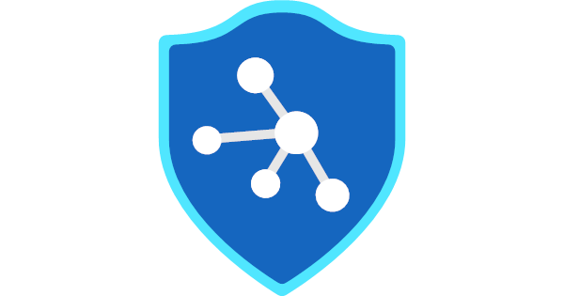
Azure Sentinel vs Azure Security Center with Azure Defender
Cybersecurity Cycle
Visibility
Analytics
Hunting
Incidents
Automation
Azure Security Center
Azure Sentinel

Slide 8
Azure Sentinel
Things that you can NOT do:
You can NOT use the same Log Analytics Workspace that is used by Azure Security Center
Once Azure Sentinel is enabled on a workspace, you can NOT move the workspace to another resource group or subscription (you have to contact Azure Sentinel Support Team to accomplish this task)
Notes:
TODO

Slide 9
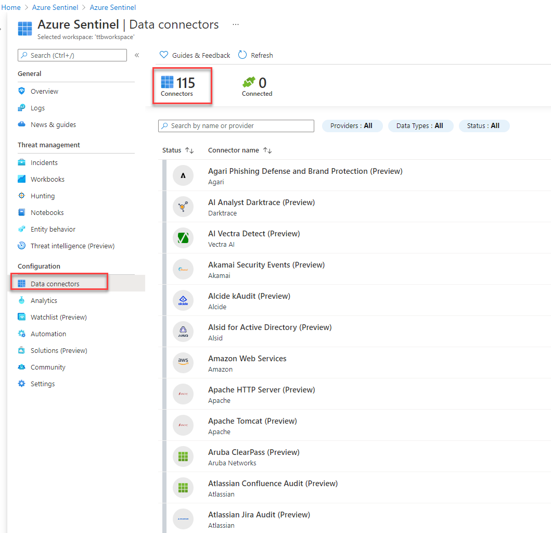
Azure Sentinel - Connectors
Over 100+ Data Connectors available for Azure Sentinel
Not only for Azure connection but external services as well.
Notes:
TODO

Slide 10
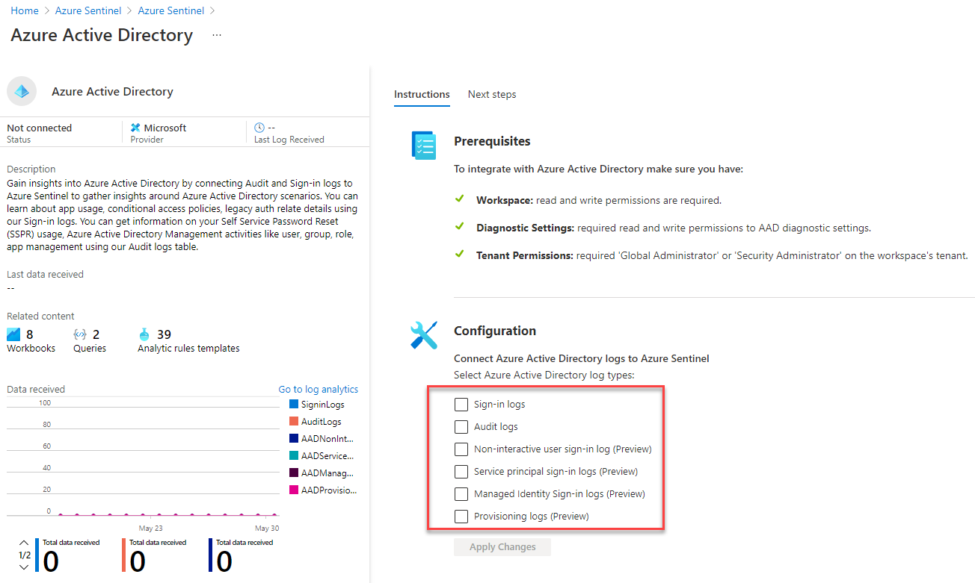
Azure Sentinel - Connectors
Example: Azure Active Directory Connector:
Notes:
TODO

Slide 11
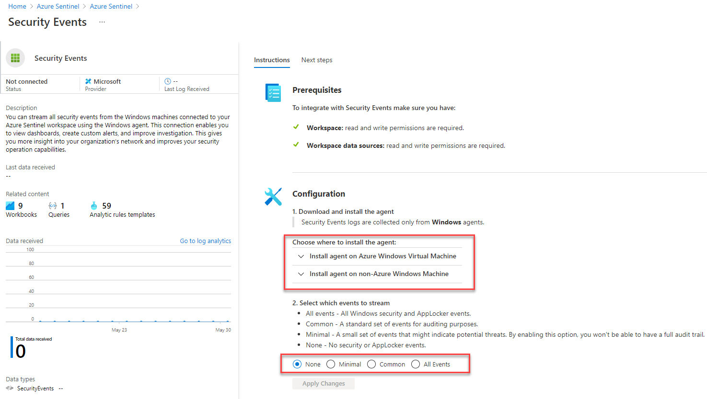
Azure Sentinel - Connectors
Example: Security Events Connector:
Notes:
TODO

Slide 12
Azure Sentinel - Incidents
TODO
Notes:
TODO

Slide 13
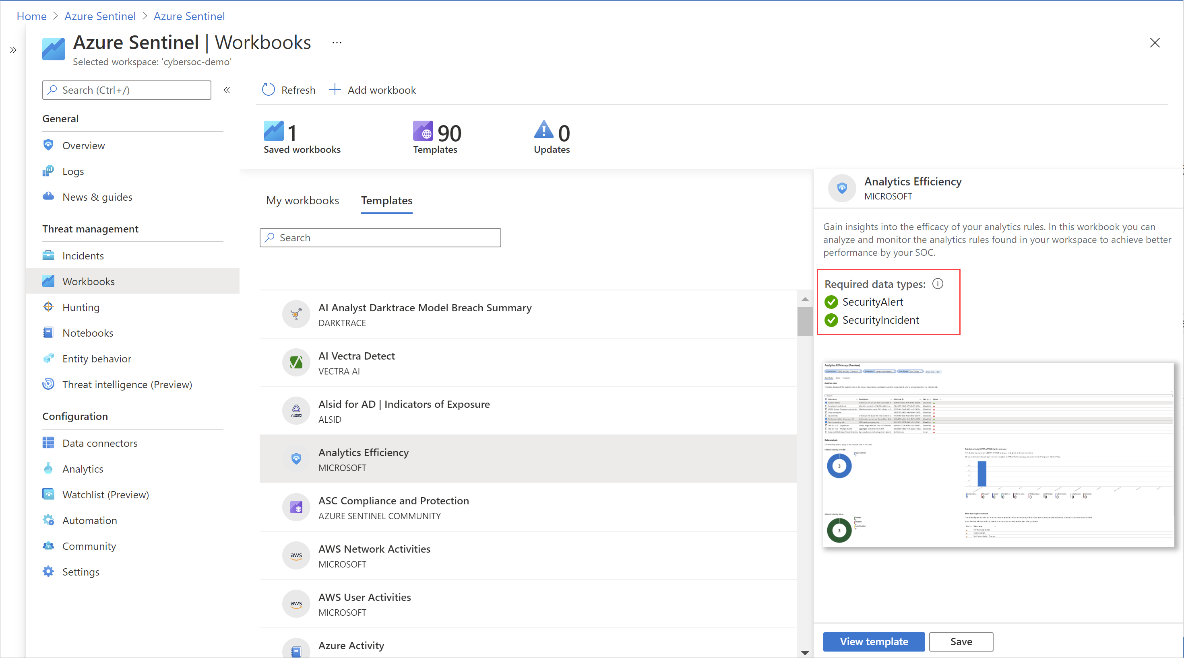
Azure Sentinel - Workbooks
Azure Sentinel integrates with Azure Monitor Workbooks
You can create Workbooks across your Data
Azure Sentinel comes with Workbook templates to allow for quick insight gain right after connecting the data.
Notes:
TODO

Slide 14
Azure Sentinel - Hunting
TODO
Notes:
TODO

Slide 15

Azure Sentinel - Notebooks
Julia Python and R ➔ Jupyter Notebooks
When to use Notebooks in Sentinel?
When triaging an incident in Azure Sentinel comes to a dead end.
Your investigation become significantly more complex
When automation ends and there is a need to find a needle in a haystack
Too much details to go through
Need persistence to pass results to the next analyst
KQL is no longer cutting it
Need to integrate with external data (WhoIs, GeoIP, etc…) not stored in the workspace
Need for ML and visualizations available already in the form of 1000s of libraries and packages.
Notes:
Notebooks in Azure Sentinel are based on Jupyter notebooks based on Julia Python and R languages.

Slide 16
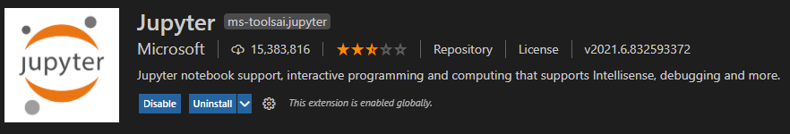
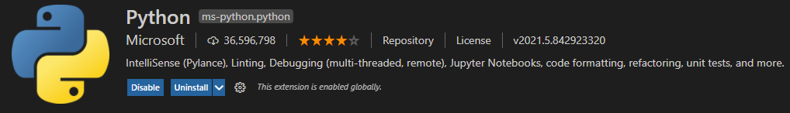
Azure Sentinel – Notebooks …
You can use Visual Studio Code to develop your Notebooks.
You can use a Local Docker Container to developer locally disconnected.
You can use %kql as a magic command to continue using your queries in the notebooks

Slide 17
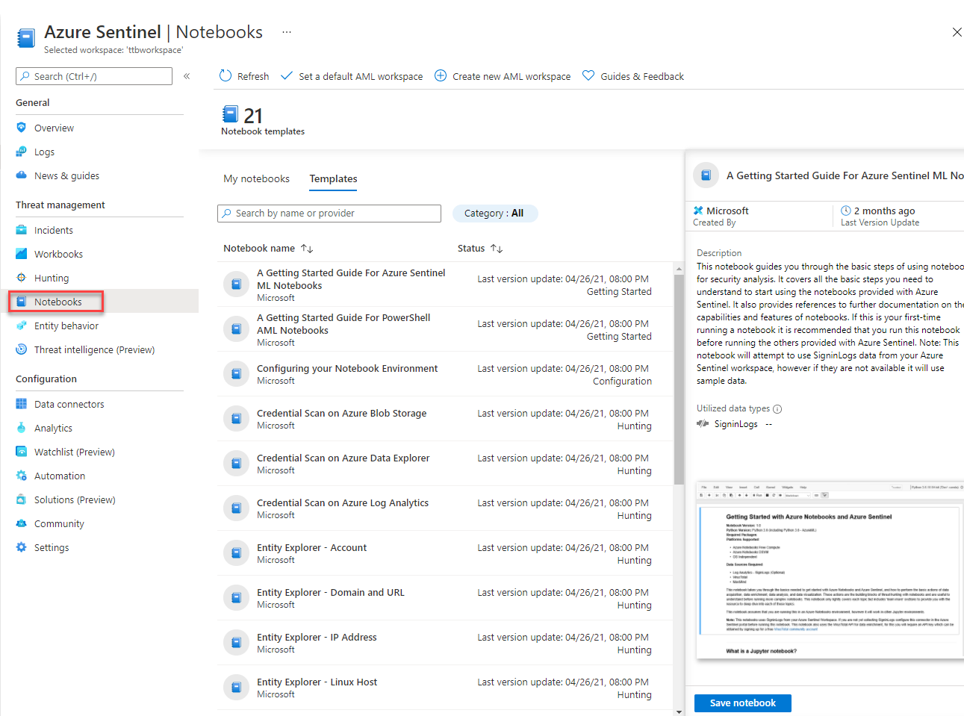
Azure Sentinel – Notebooks …

Slide 18
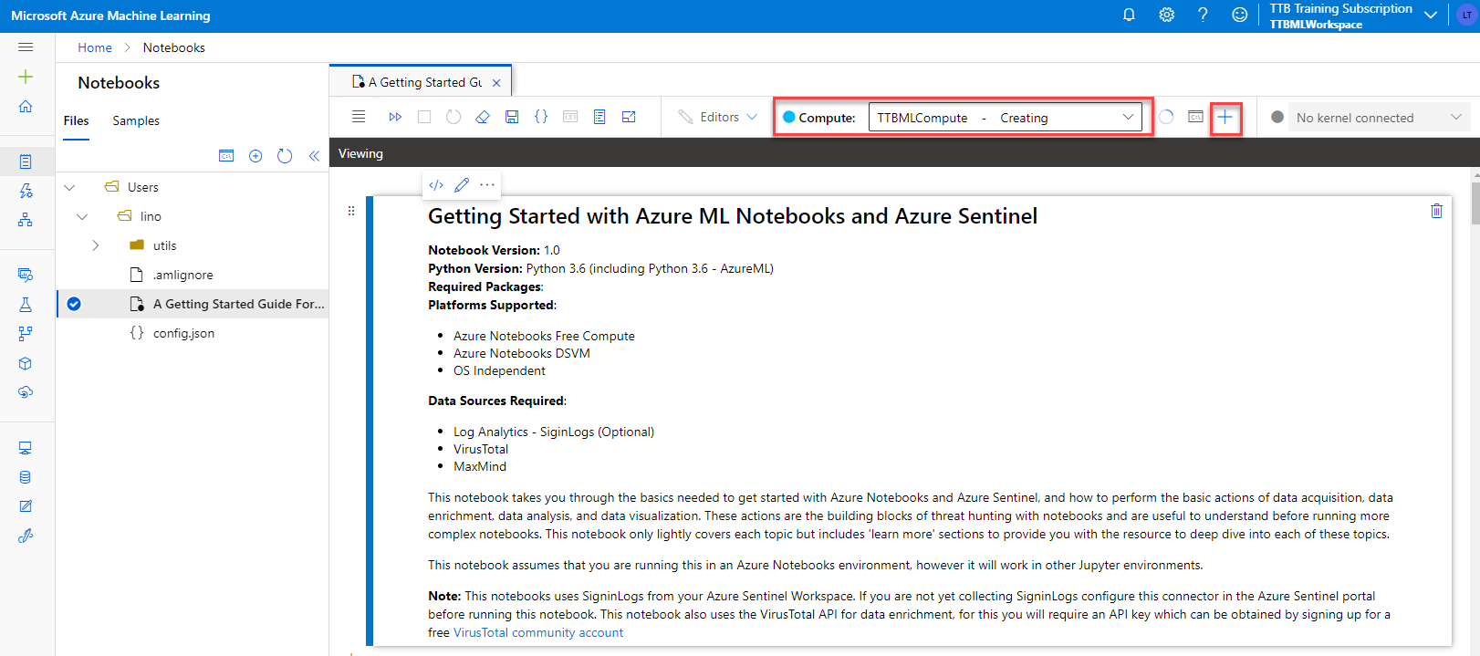
Azure Sentinel – Notebooks …
Notes:
Choosing the ML Template Notebook to use with Azure Sentinel
You have to choose a Compute to start using the Notebook
You will need to Authenticate from the notebook to use any Azure SDK

Slide 19
Azure Sentinel – Entity Behavior
TODO
Notes:
TODO

Slide 20
Azure Sentinel – Threat Intelligence
TODO
Notes:
TODO

Slide 21
Azure Sentinel – Analytics
TODO
Notes:
TODO

Slide 22
Azure Sentinel – Automation
TODO
Notes:
TODO

Slide 23
Azure Sentinel – SIEM Integration
TODO
Notes:
TODO

Slide 24
Security Operations Center

Slide 25
Security Operations Center
TODO
Notes:
TODO

Slide 26
Thank You slide
Break

Slide 27
Welcome Back!
7:00-7:05 | Welcome
7:05-7:15 | Keynote
7:15-7:45 | Demo Walkthrough
7:45-8:00 | Break
8:00-9:00 | Data Loading & Data Lake Organization
9:00-10:00 | Activity: Data Lake Design & Security Considerations | Table Group Call
10:00-10:15 | Break
10:15-11:00 | Build Hands-on: Data Integration Part 1 | Table Group Call
11:00-12:00 | Break | Main Call
12:00-12:30 | Data Transformations
12:30-13:00 | Activity: Data Engineering Discussion | Table Group Call
13:00-14:00 | Build Hands-on: Data Integration Part 2
14:00-14:15 | Closing | Main Call
Presentation/
Whole Group
Lab
Activity/ Discussion/ Group Work
Announcements

Slide 28
Better together!

Slide 29
End to End Investigations
TODO
Notes:
TODO

Slide 30
Troubleshooting
TODO
Notes:
TODO

Slide 31
KQL Unions
TODO
Notes:
TODO

Slide 32
Product Integration

Slide 33
Product Integration
TODO

Slide 34
Hunting

Slide 35
Hunting
TODO

Slide 36
Pop Quiz
Which one of these is NOT a component of a Synapse pipeline?
A) I.R.
B)
Linked Service
C)
Table
D) Activity

Slide 37
Best Practices

Slide 38


Question…
How many different methods of loading ADLS can you think of?
What about a Synapse SQL Pool?

Slide 39
Best Practices
TODO
Notes:
The ? Mark is the knowledge center

Slide 40
Thank You slide
Break

Slide 41
Breakout Activity: Data Lake Design & Security Considerations
As a result of participating in this activity, you will better be able to design, optimize and secure a file system within ADLS Gen2.
OUTCOMES
ACTIVITY
60 minutes
Learning Adviser
Table Group Channel
As a team review WWI requirements provided in student guide
Open the whiteboard and as a team answer the provided challenge questions.
The questions are pre-loaded into the whiteboard.
Welcome | Keynote | Demo Walkthrough | Break | Data Loading & Data Lake Organization | Activity: Data Lake Design & Security Considerations | Break | Lab: Data Integration Part 1 | Break | Data Transformations | Activity: Data Engineering Discussion | Lab: Data Integration Part 2 | Closing

Slide 42
Build Hands-on Lab: Azure Defender Part 1
As a result of participating in this lab, you will be better able to deploy azure defender protections
OUTCOMES
ACTIVITY
60 minutes
Independent
Table Group Channel & CloudLabs Environment
Independently review and complete Exercises 1-4 in the Lab 1 Guide.
Login to your CloudLabs environment and work through a set of tasks you would typically follow in work associated with ingesting and integrating your customer’s data.
The Lab Guide is available in the ‘Files’ tab of the General channel. Engage your Table Group call for support and troubleshooting.
Welcome | Keynote | Demo Walkthrough | Break | Data Loading & Data Lake Organization | Activity: Data Lake Design & Security Considerations | Break | Lab: Data Integration Part 1 | Break | Data Transformations | Activity: Data Engineering Discussion | Lab: Data Integration Part 2 | Closing

Slide 43
Welcome Back!
8:00-8:05 | Welcome | Main Call
8:05-8:15 | Keynote
8:15-8:45 | Demo Walkthrough
8:45-9:00 | Break
9:00-10:00 | Azure Defender File Integrity + Container Image Scanning
10:00-10:15 | Break | Table Group Call
10:15-11:15 | Azure Defender Adaptive Application Control + Adaptive Network Hardening
11:15-12:15 | Build Hands-on: Azure Defender Part 1
12:15-1:15 | Break | Main Call
1:15-2:15 | Azure Defender VM/SQL Vulnerability Assessments | Main Call
2:00-3:00 | Activity: Data Engineering Discussion | Table Group Call
3:00-4:00 | Build Hands-on: Azure Defender Part 2
4:00-4:15 | Closing | Main Call
Presentation/
Whole Group
Lab
Activity/ Discussion/ Group Work
Announcements

Slide 44
Thank You slide
Thank you

Slide 45
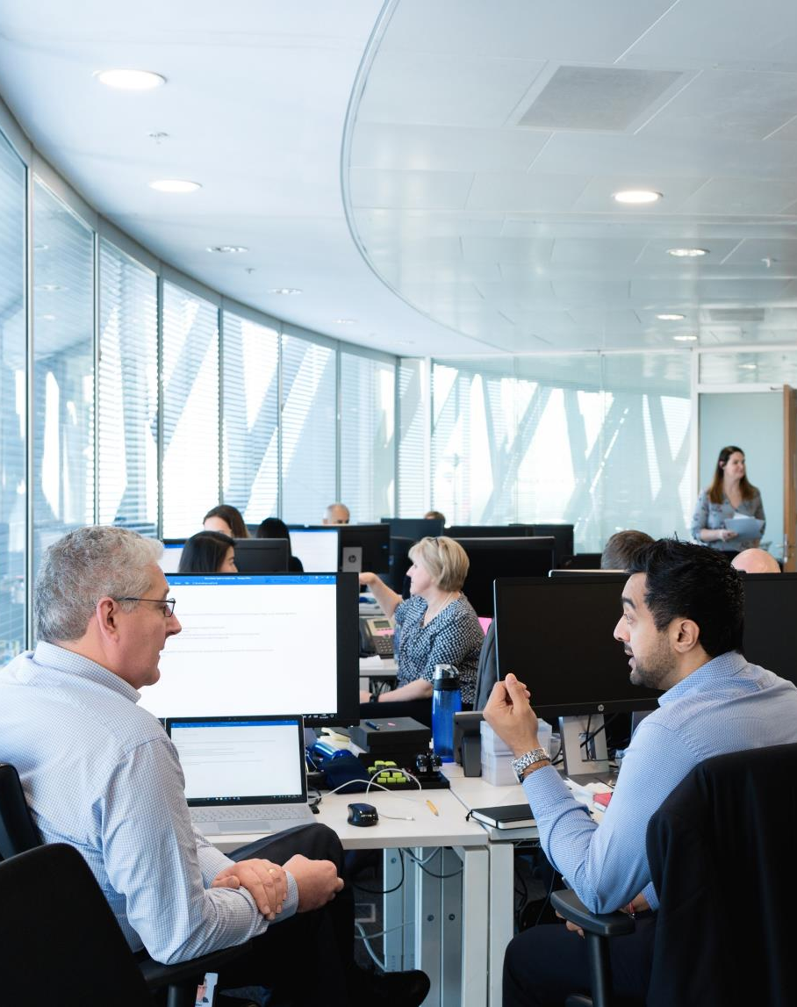
Full Group Activity: Azure Defender
Objective: As a result of participating in this activity, you will better be able to TODO.
What you will be doing: The facilitator will be posting questions to the entire group using an interactive tool called Mentimeter. The answers you post using Mentimeter will then drive the discussion.
Total Activity Time: 30 minutes

Slide 46
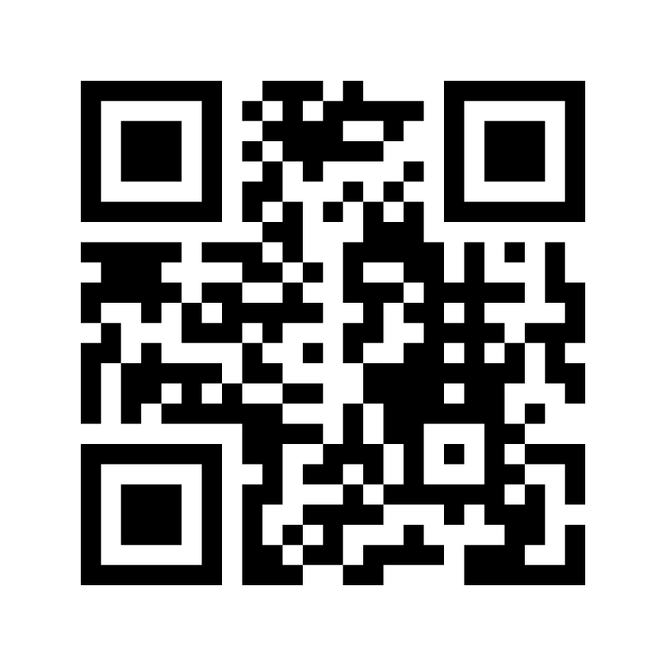
Mentimeter Poll
Scan QR Code
or Go to www.menti.com and use code
1183 9575
Notes:
https://www.menti.com/9r2wwujwag

Slide 47

Hands-On Build Activity: Azure Defender Part 2
Objective: As a result of participating in this lab, you will be better able to TODO.
What you will be doing: Like the Part 1 exercise, you work individually in your lab environment to complete a set of tasks you would typically follow in work associated with ingesting and integrating your customer’s data. A set of tasks are outlined for you to follow and complete.
Total Activity Time: 60 minutes

Slide 48


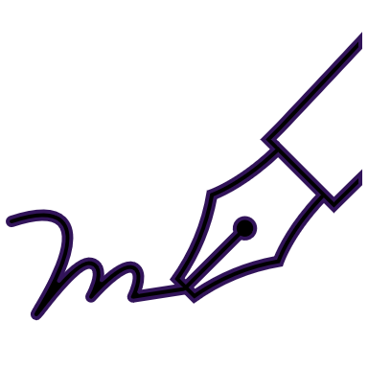






Lab: individual lab exercise
Step 1: Go to your table group channel
Step 2: Your Learning Adviser will provide you a unique cloud lab login link
Step 3: Login and begin the lab. Engage your table group via a Microsoft Teams “meet now” call to support each other (meet now button in upper right corner of application)

Slide 49
Closing
Thank you for your participation in today’s Azure Synapse Technical Boot Camp!
We learned:
TODO
TODAY
We will learn to:
TODO
TOMORROW

